Slide 1


Quantifying Systemic Risk in Europe
A Bayesian Approach to Map Financial Contagion Through CDS Spreads
Supervisor
Prof. Luca Rossini
Assistant Supervisor
Prof.ssa Silvia Salini
Graduand
Ivo Bonfanti

Slide 2





Motivations - Public Debt
2007
2022
2019
European public debt has grown a lot in recent decades…
91%
of GDP
Ukraine war
Covid-19
Great Recession
…a debt burdening on future generations more than ever...
62% of GDP
Source: Eurostat

Slide 3








Motivations - Great Recession
…economic growth is cardinal for diminishing countries’ debts…
Greece international bailout
Losses in the value of global listed companies:
€16 trillion (1.5 EU GDP)
90s
2000s
2008
2009
2010
Low inflation
Low interest rates
Ample liquidity
House purchased
Borrower defaults
Subprime mortgage
Foreclosure
Lehman Brothers bankruptcy
and AIG bailout
…but financial instability can become a serious impediment.

Slide 4






Motivations - Systemic Risk
“Regulators and supervisors focused on the micro-prudential supervision of individual financial institutions and not sufficiently on the macro-systemic risks of a contagion of correlated horizontal shocks.” -The Larosière Report, EU, 2009-
“With respect to macroeconomic policy, policymakers failed to take sufficiently into account growing macroeconomic imbalances that contributed to the buildup of systemic risks in the financial system and in housing markets.” –Annual Report, IMF, 2009-
“The financial and economic crisis that has shaken the world economy for more than two years illustrates the relevance of systemic risk.”…”The objective is to characterise the phenomenon of systemic risk from an academic research perspective.”…”three main “forms” of systemic risk: the contagion risk, the risk of macro shocks causing simultaneous problems and the risk of the unravelling of imbalances that have built up over time.” -Financial Stability Review, ECB, 2009-

Slide 5


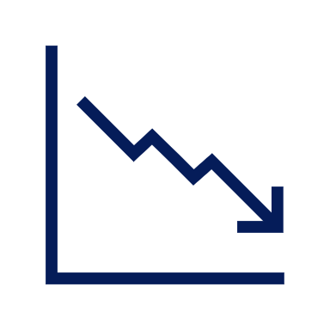
Systemic Risk - Financial Contagion
Among the banking instability sources the most prominent is the dense network of connection between intermediaries.
The concurrent failure of a handful of large financial institutions could trigger a severe and pervasive economic crisis.
Potentially having serious negative consequences for the real economy.
«
Systemic risk means a risk of disruption in the financial system with the potential to have serious negative consequences for the internal market and the real economy. All types of financial intermediaries, markets and infrastructure may be potentially systemically important to some degree.
-EU Regulation 1092/2010-
«

Slide 6











Credit Default Swap - Functioning
It is a financial derivative working similarly to an insurance contract.
1
P.B.
P.B.
P.S.
P.S.
The contract
is settled.
Notional amount
Reference entity
2
P.S.
P.B.
Contingent event
Fixed premium
Tenor
×
P.B.
P.S.
3

Slide 7




Credit Default Swap - A Proxy for Financial Contagion
The spread incorporates information on how the market perceives the creditworthiness of a reference entity.
Spreads co-movements carry information on the reference entities level of interdependence.
A tightly interconnected network of institutions fosters the rapid spread of financial contagion, posing systemic risk. High interdependence among market participants amplifies shocks across the system.
Solvency
Spread

Slide 8

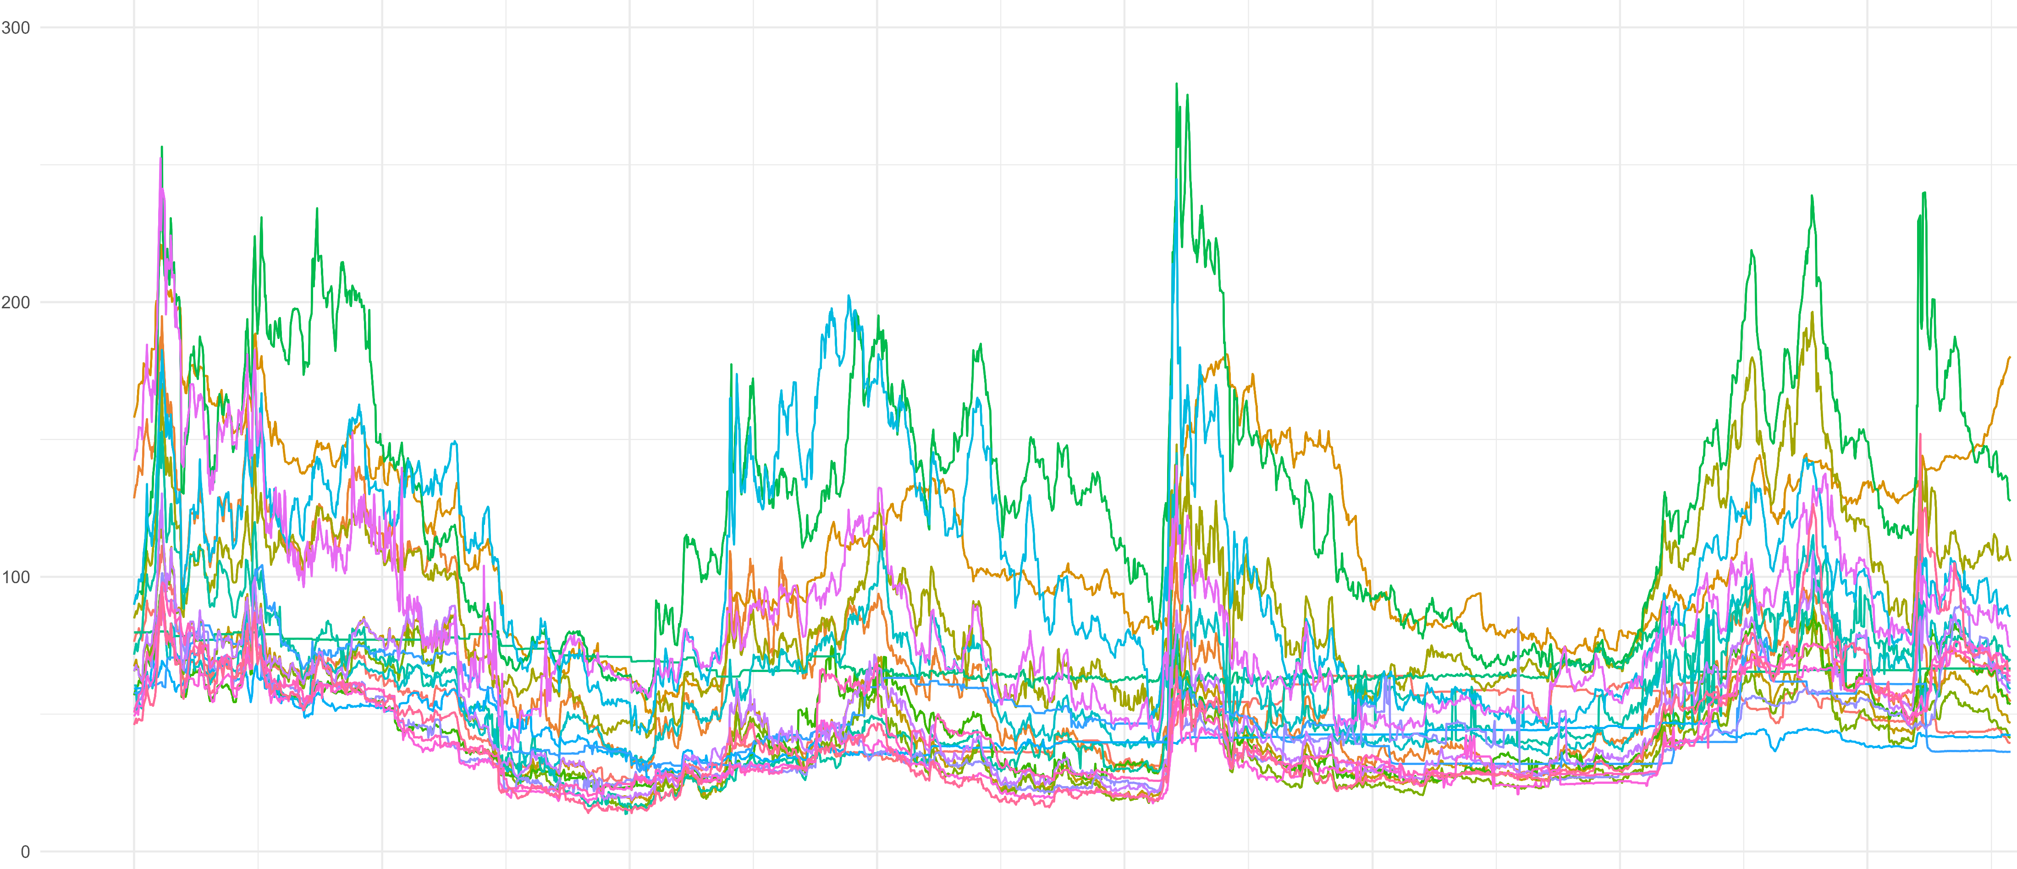
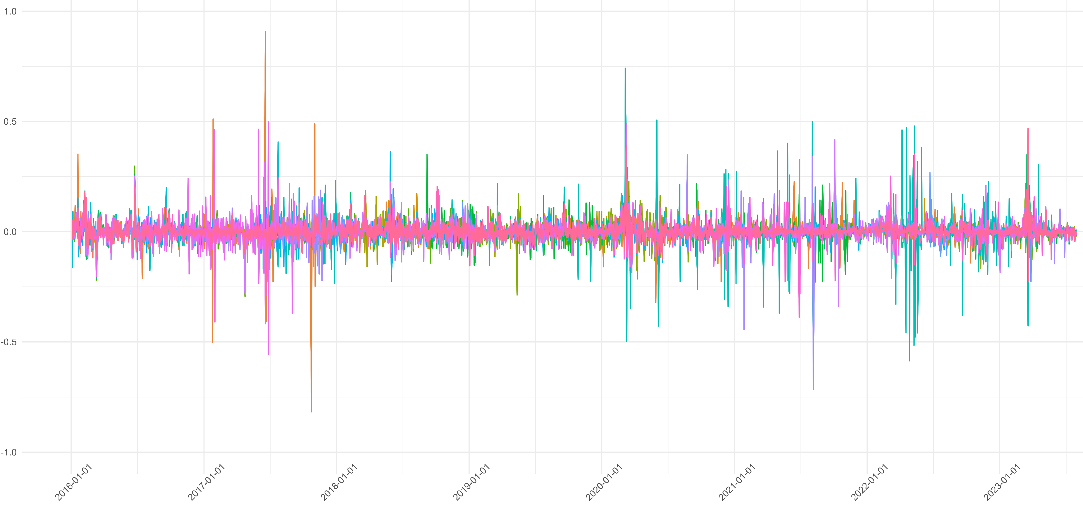

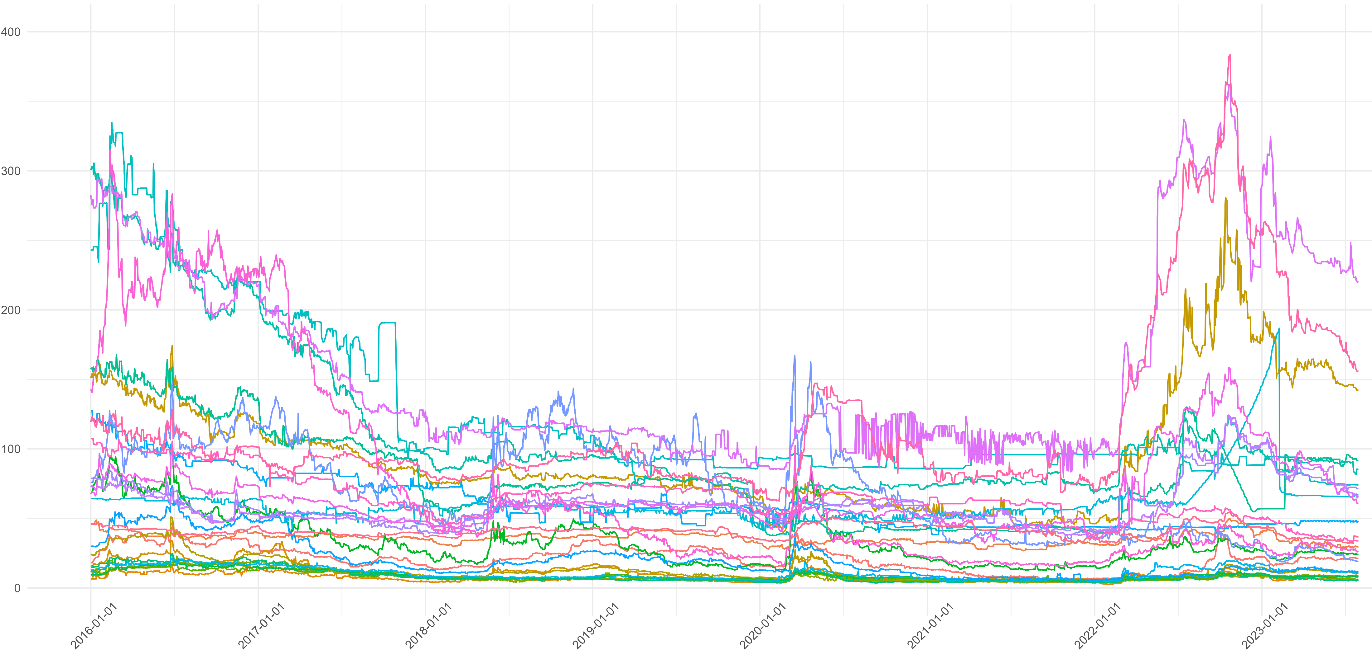

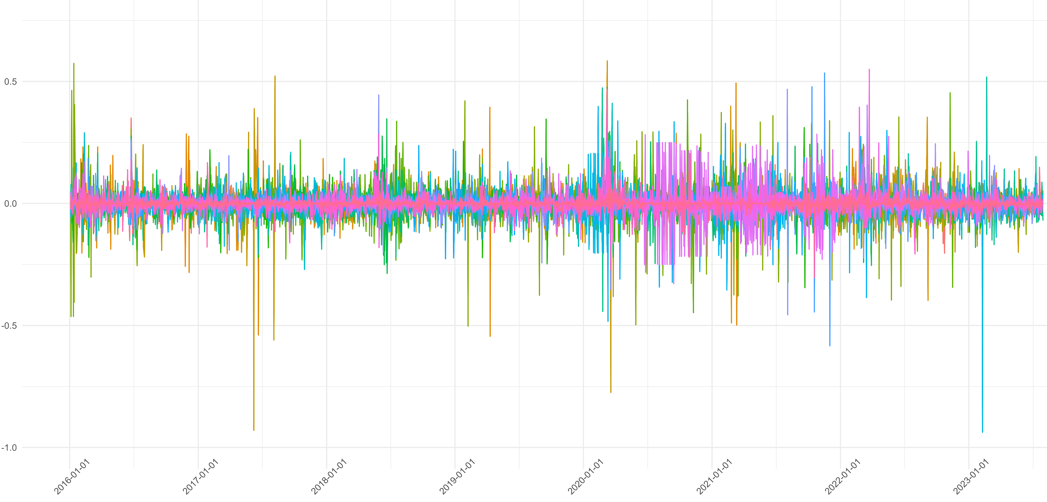


Credit Default Swap - Datasets
IHS Markit
5 years
21 European
banks
29 European countries
Daily
[01/01/2016-31/07/2023]

Slide 9
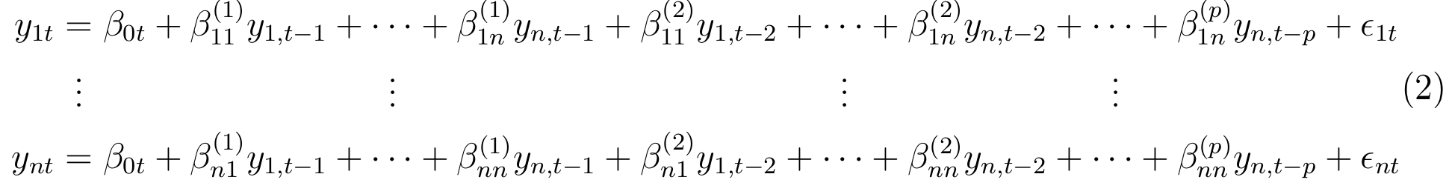
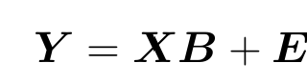
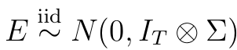
Vector Autoregression - Model
The VAR model is a well established model for estimating multivariate time series…
Spread entity 1 time t
Spread entity n lag p
n×1
n×1
n×n
n×1
Parameters to be estimated
Effect entity 1 lag 2 on entity n
Residual entity n time t
…each variable is modeled as a linear combination of its past values as well as the past values of all other variables in the system.
where

Slide 10

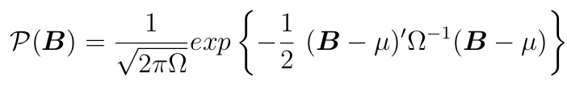
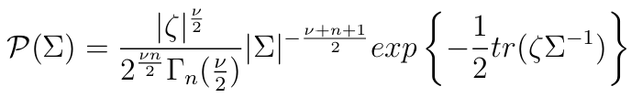
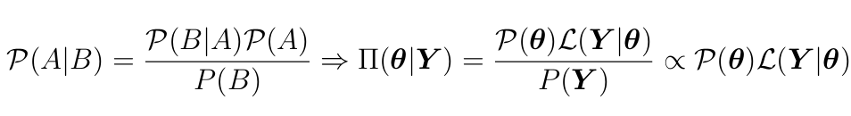
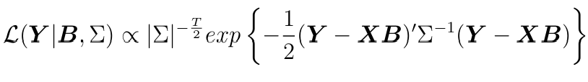
Bayesian VAR - Parameters estimation
Θ=[B; Σ]
Y=Data
Bayesian theorem
Posterior distribution

Slide 11
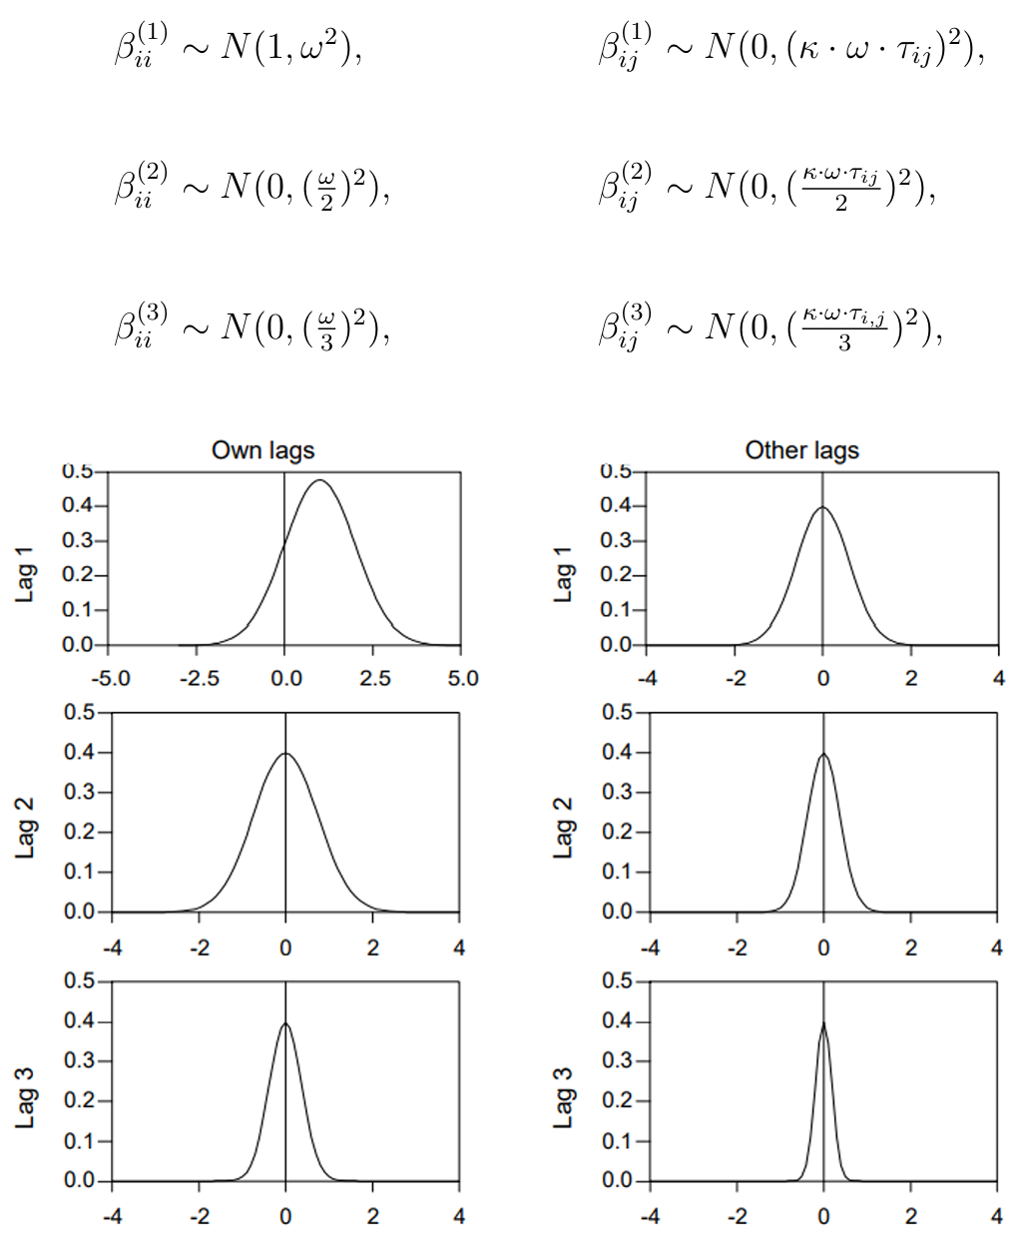
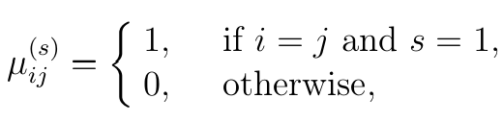
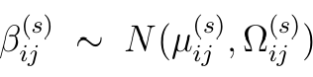
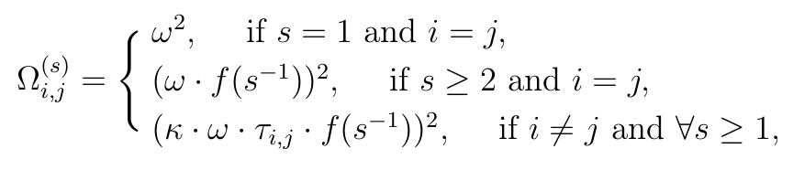

Minnesota Prior – Shrinking distribution
To handle the typical VAR overparameterization issue…
j^{(t−s)}
i^{(t)}

Slide 12

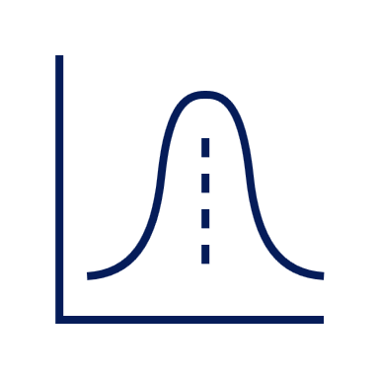
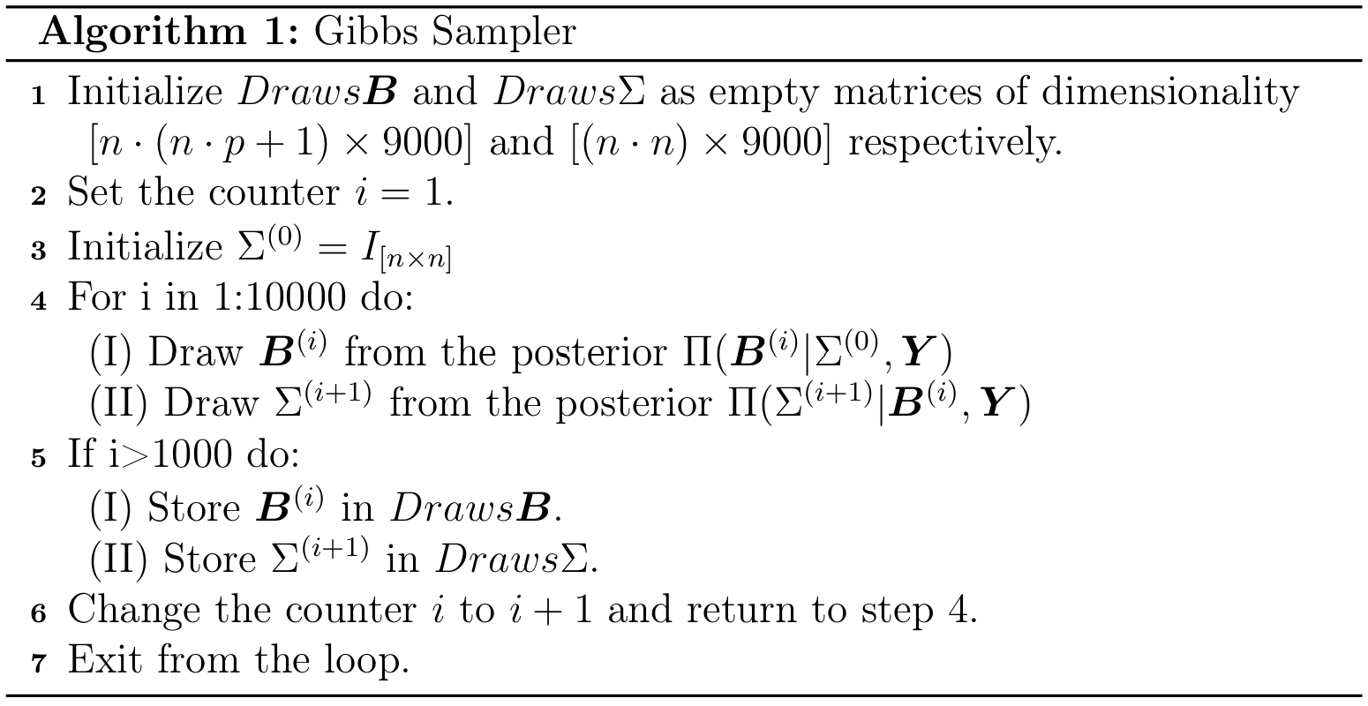
Gibbs Sampling - Estimation
Π(B|Σ,Y)
Π(Σ|B,Y)
A Markov Chain Monte Carlo method to simulate realizations from the full posterior distribution…

Slide 13
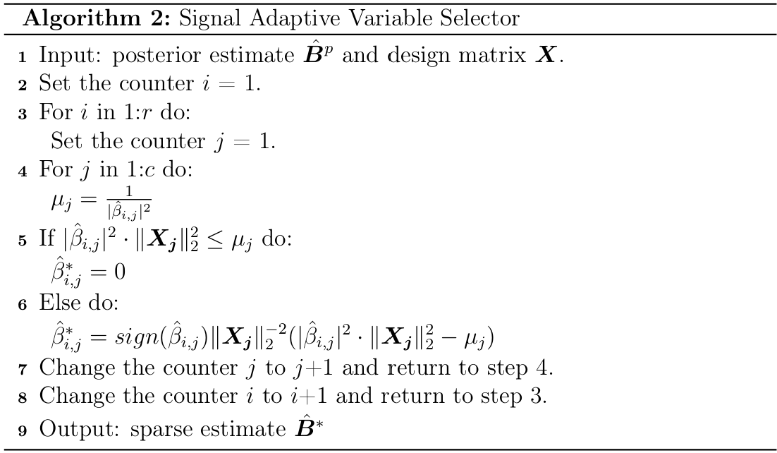
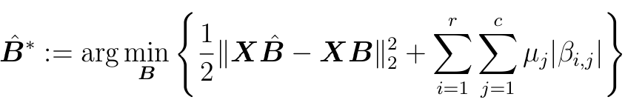
Signal Adaptive Variables Selector - Sparsity
…the Signal Adaptive Variable Selector is an automated post-processing technique useful for distinguishing between signal and null parameters…
Sparse
Shrank
Design matrix
Penalization term
1 1 0 1
1 0 1 1
1 1 1 1
0 1 0 0
1 0 1 0
0 0 0 0
…the matrix of estimated coefficients is sparsified to enhance interpretability.

Slide 14

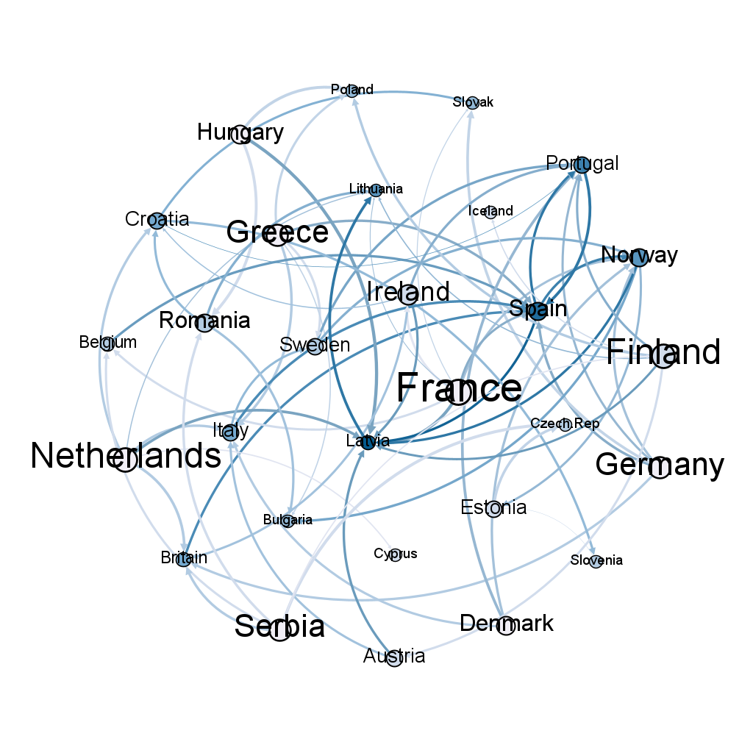
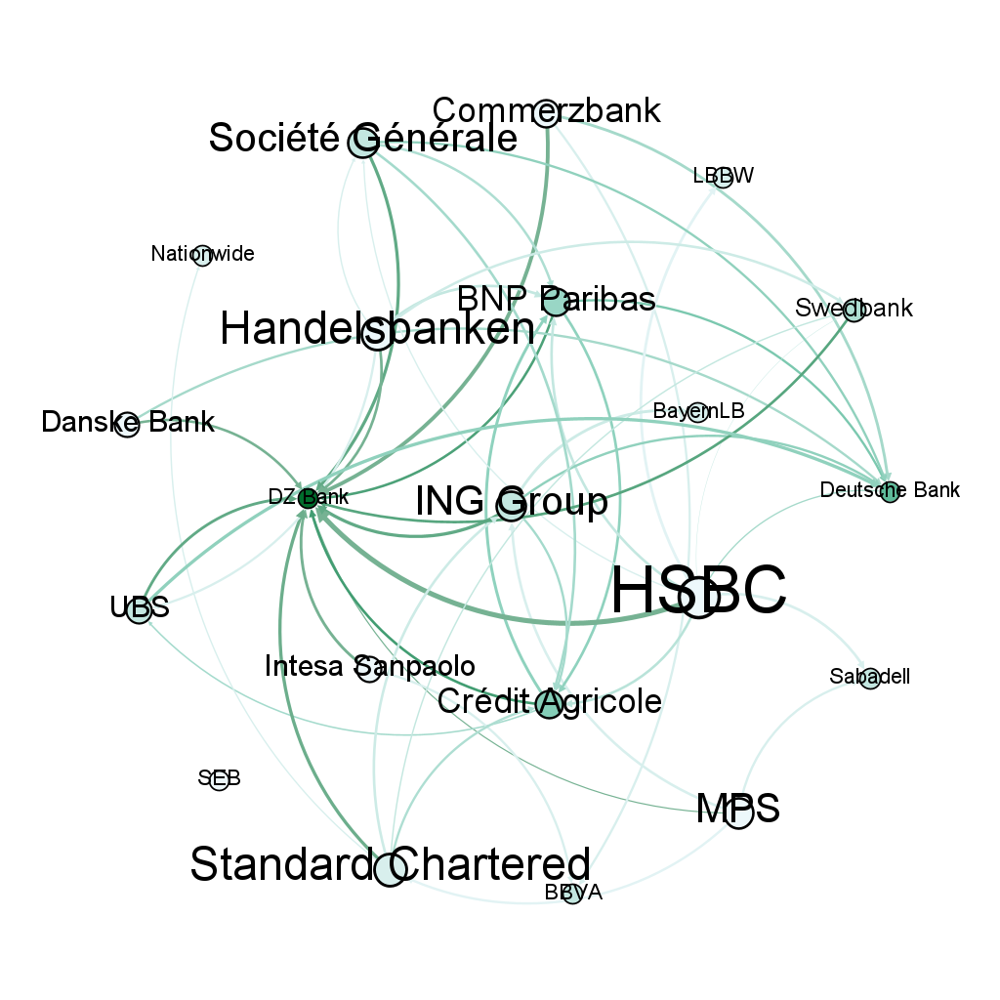
Results - Full Period BVAR
01/01/2016
-------------
31/07/2023

Slide 15
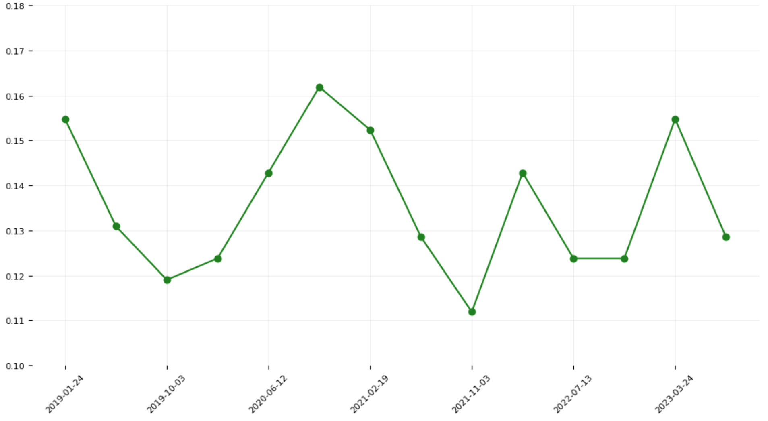



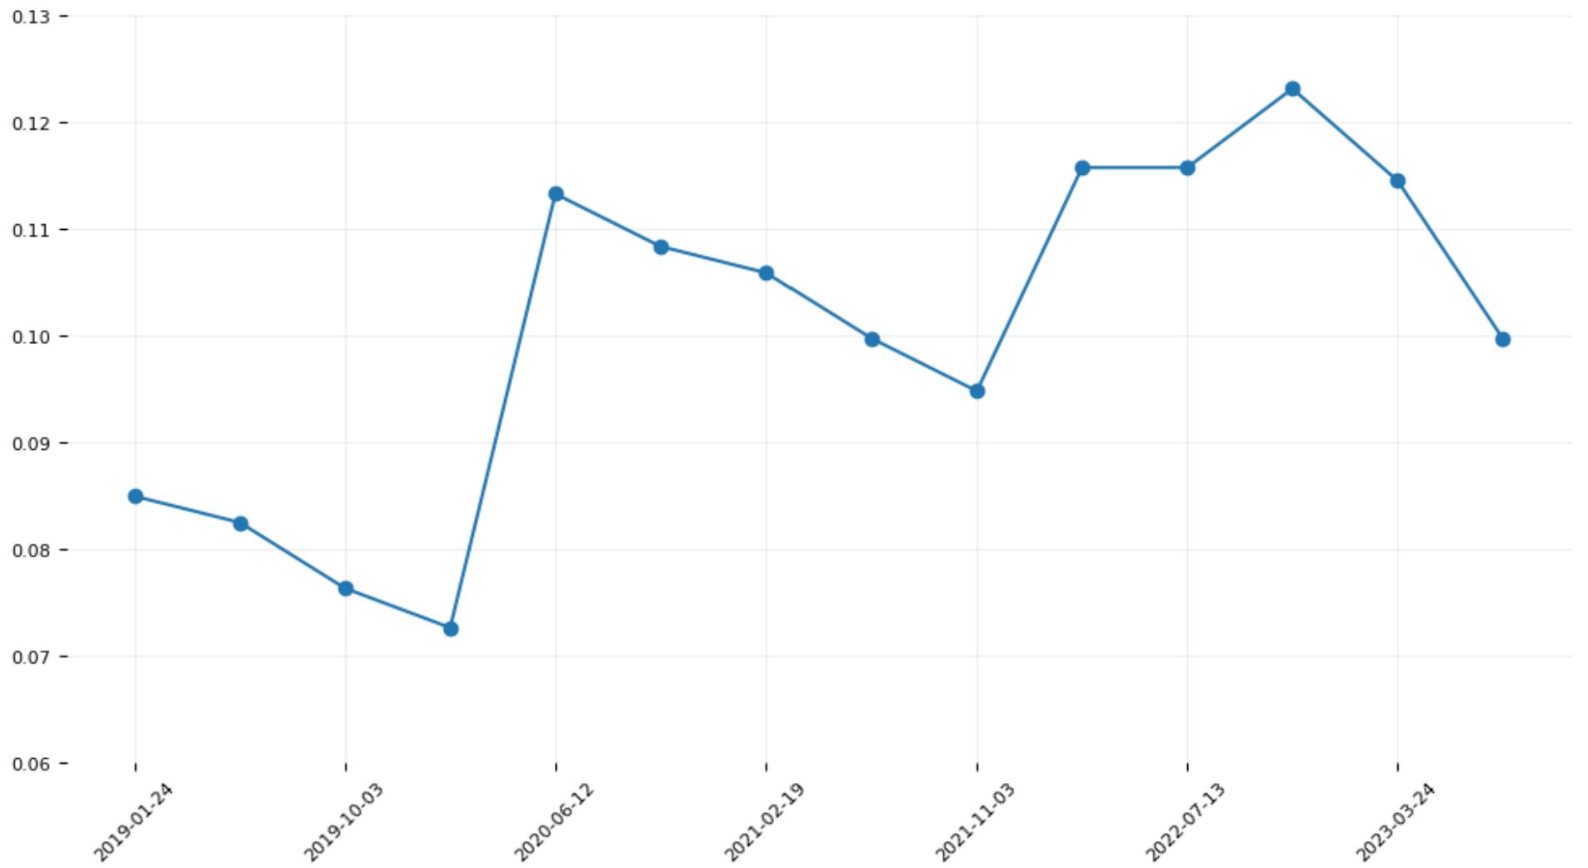
Results - Rolling Window BVAR: Densities
01/01/2016
31/07/2023
1
2
DENSITIES
90
3
4
14
791
To determine how the networks describing spreads co-movements evolve through time.

Slide 16
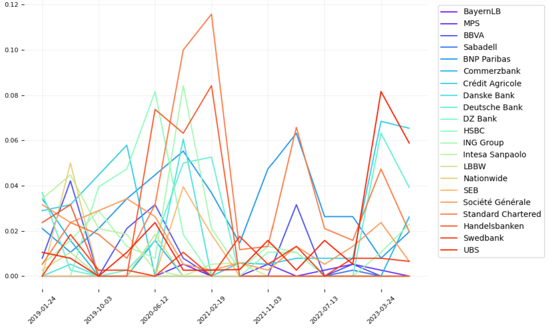
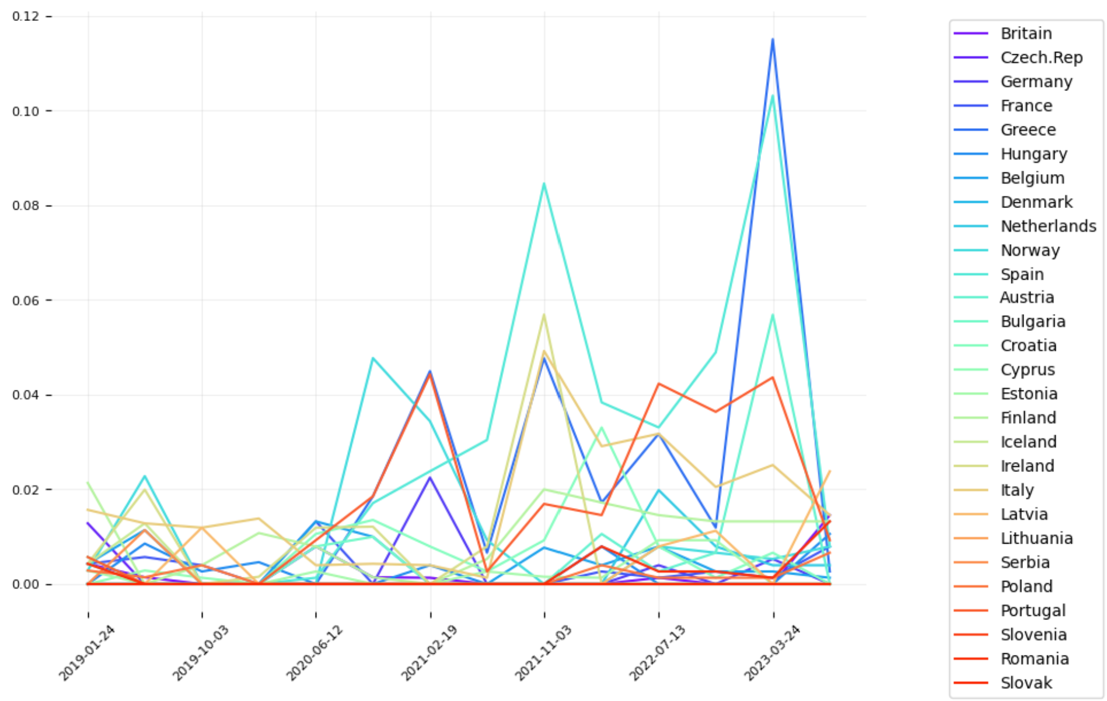
Results - Rolling window BVAR: Betweenness Centrality
Measures the extent to which a node lies on paths between other vertices…
1-Greece
2-Spain
…nodes with high betweenness have considerable influence within a network.
1-S.Chartered
2-Handlesbanken
3-ING Group
4-HSBC
1-S.Chartered
2-BNP Paribas
1-UBS
2-Cr.Agricole
3-Deutsche Bk

Slide 17
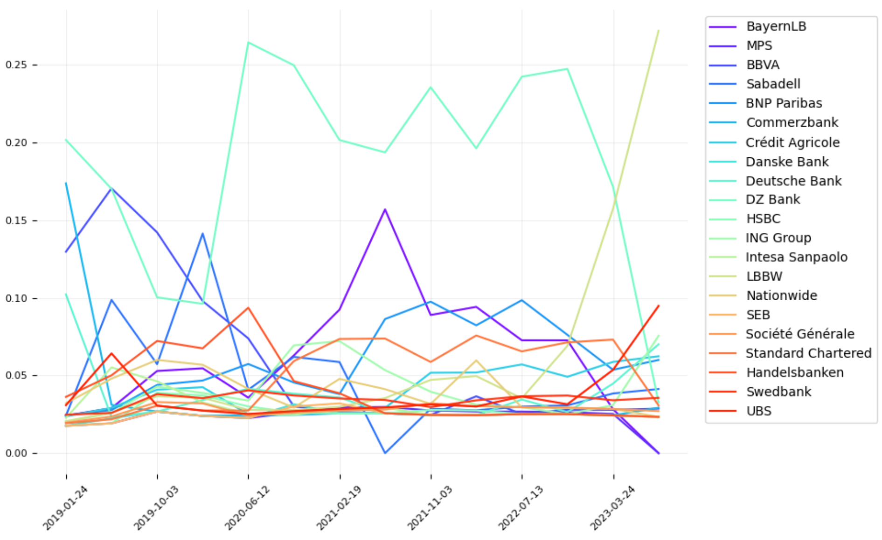
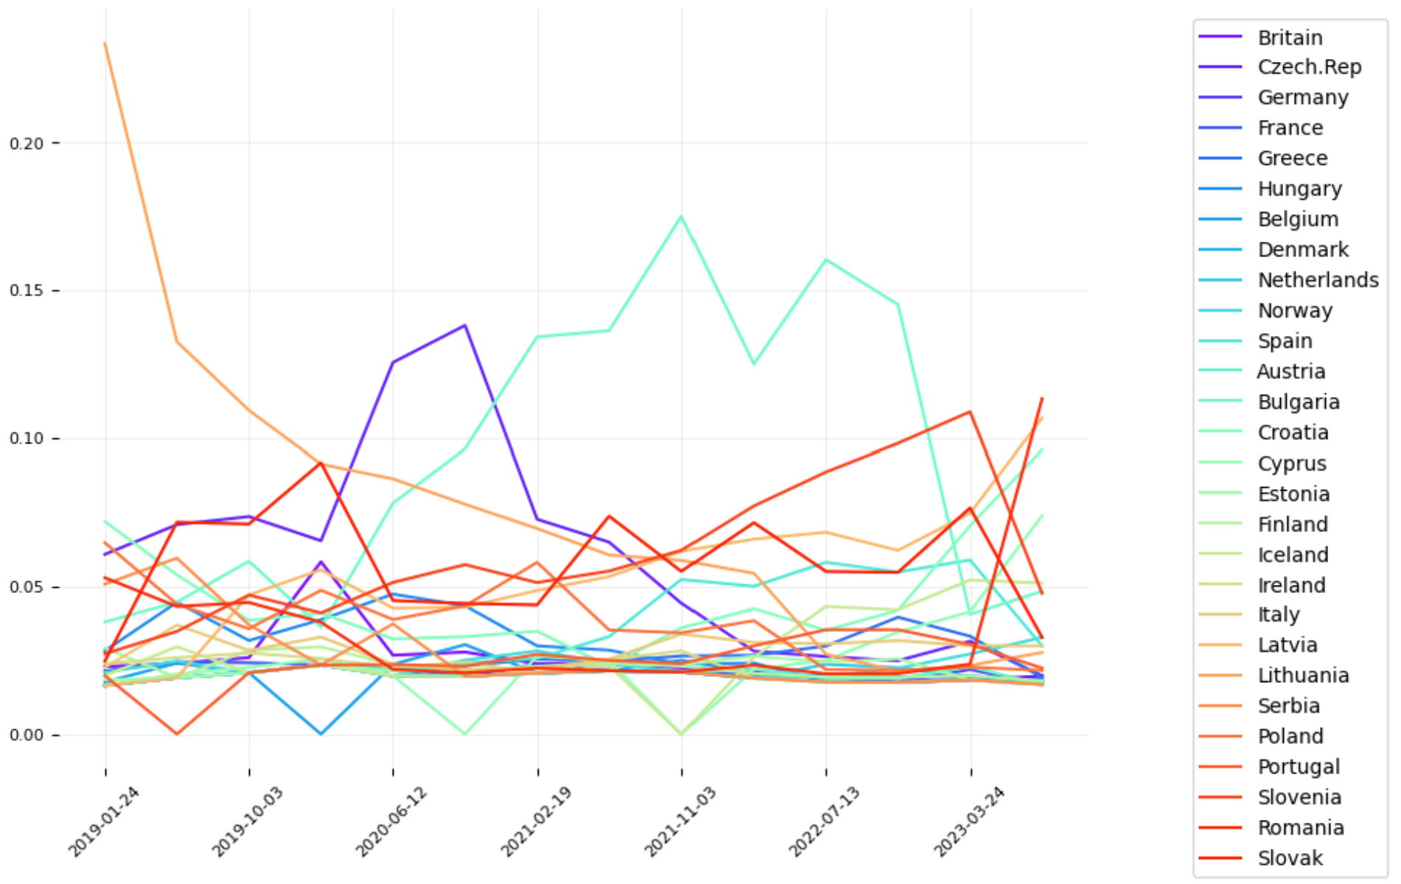
Results - Rolling Window BVAR: Page Rank
It quantifies how influenceable is a node within a network, by considering how influenceable are the connected nodes…
Lithuania
Czech Rep.
Bulgaria
…to determine the vulnerability of each node, thus its level of exposure with respect the others.
DZ Bank
LBBW

Slide 18









Conclusions - Recap
Call for Action
Public Debt
Bayesian
CDS
Networks
0 1 0 0
1 0 1 0
0 0 0 0
Economic
Growth
VAR
SAVS
Interconnectedness

Slide 19
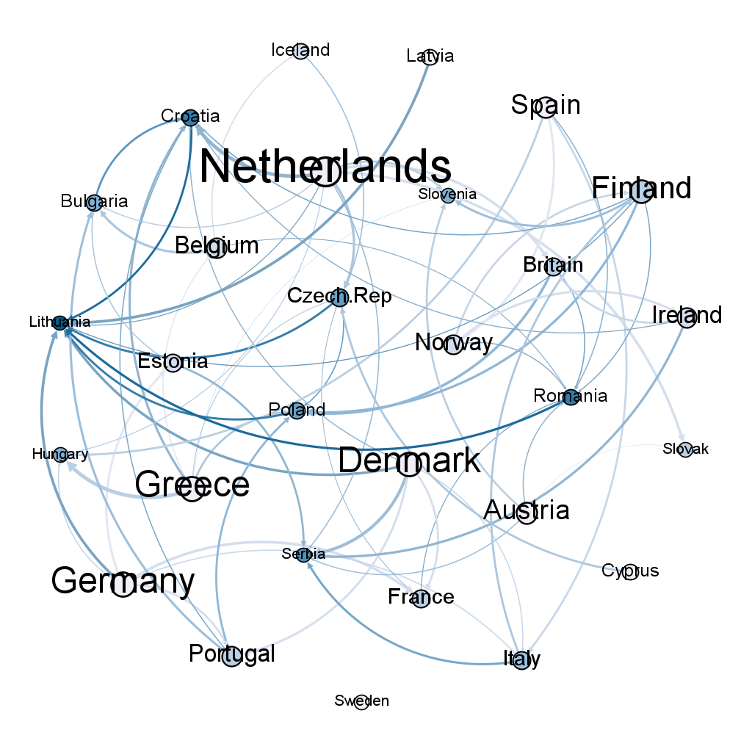
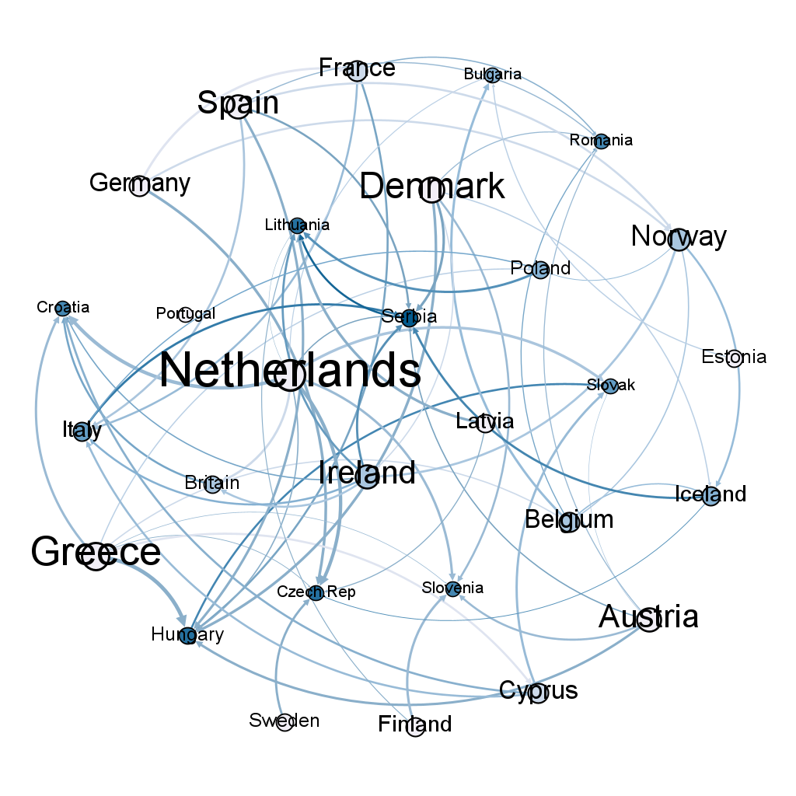
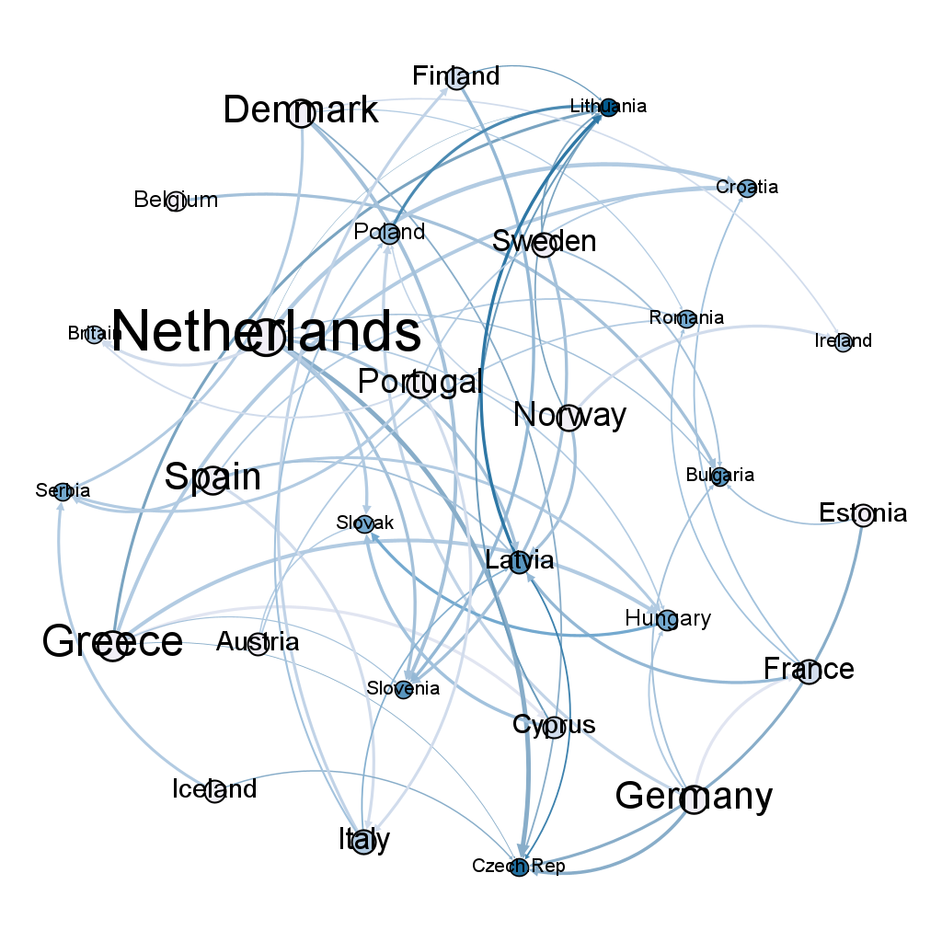
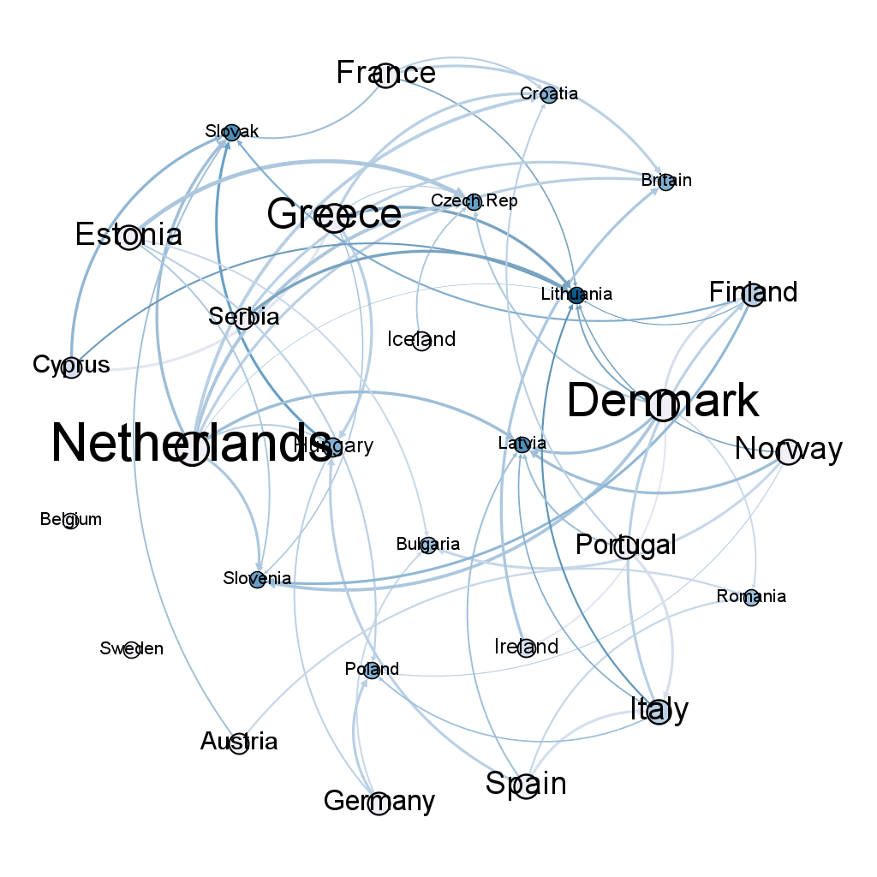
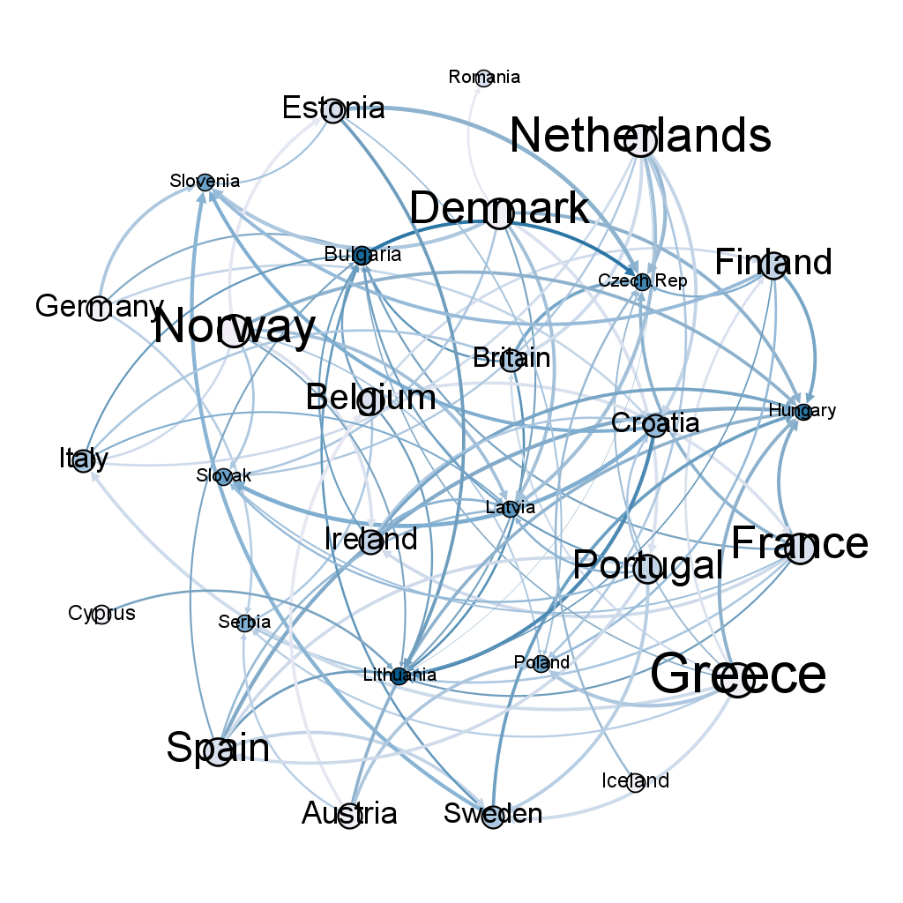
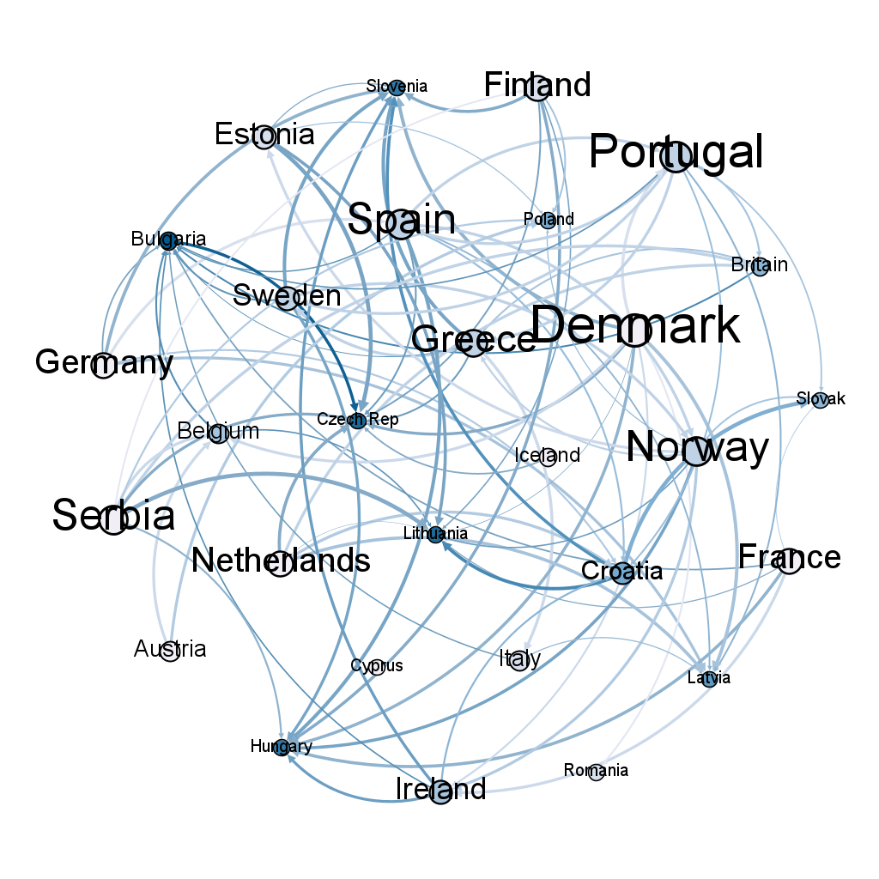
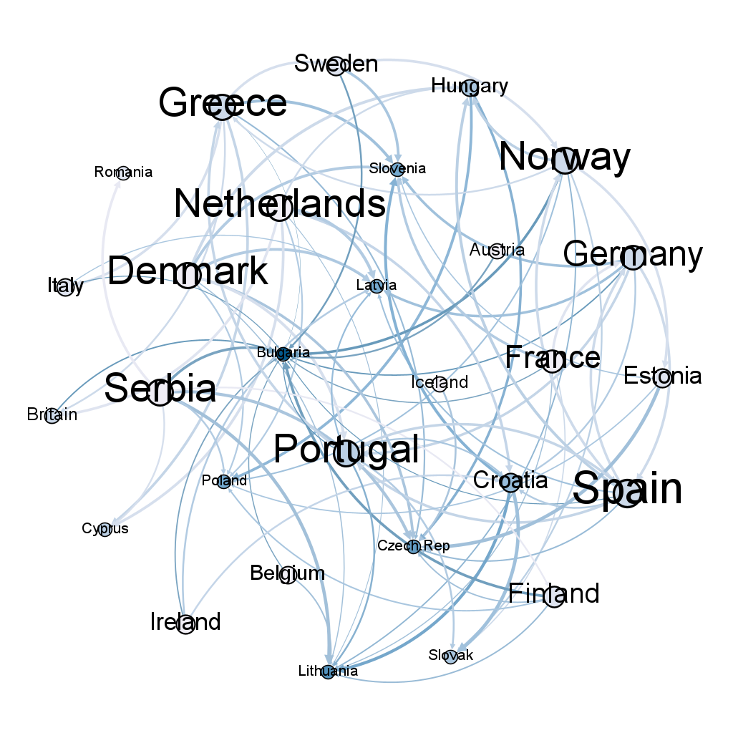
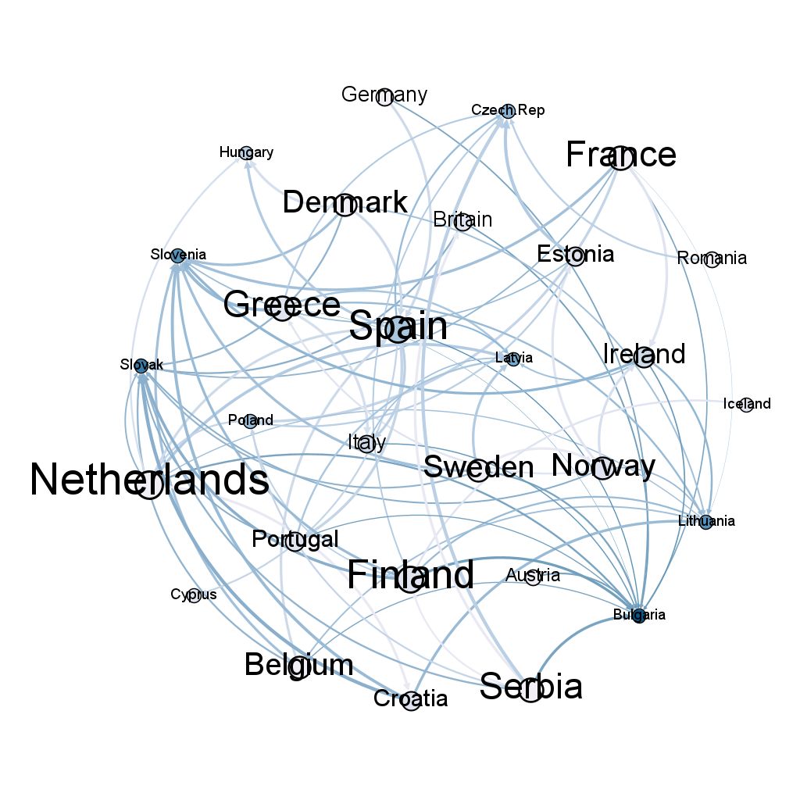
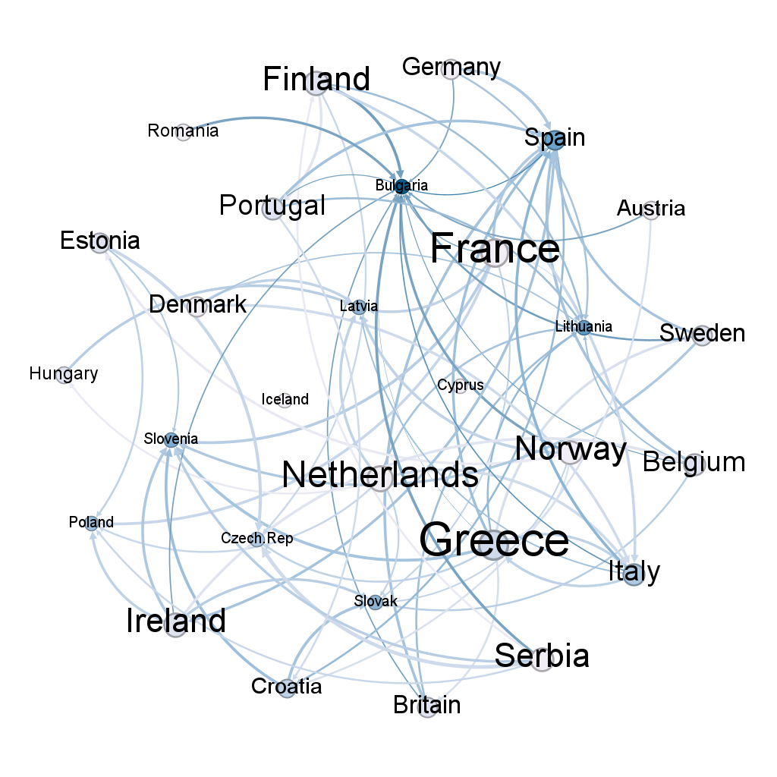
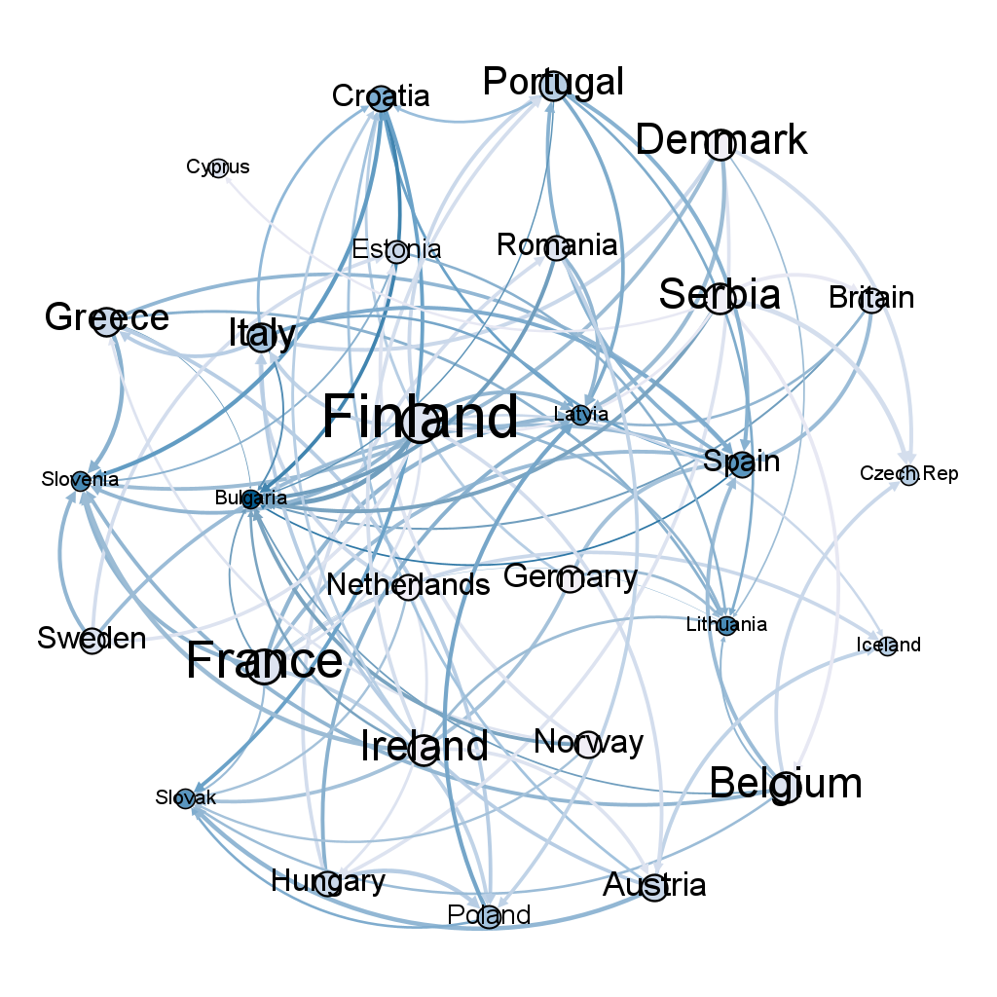
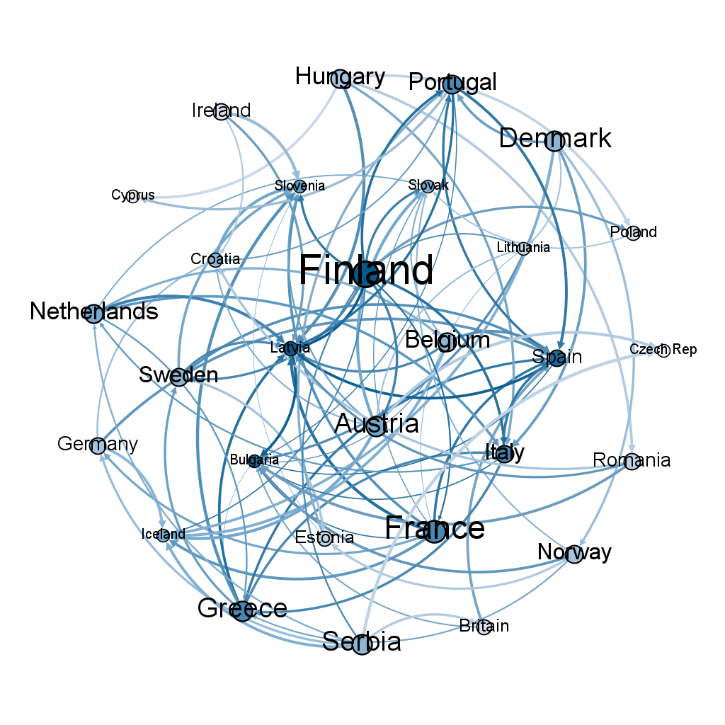
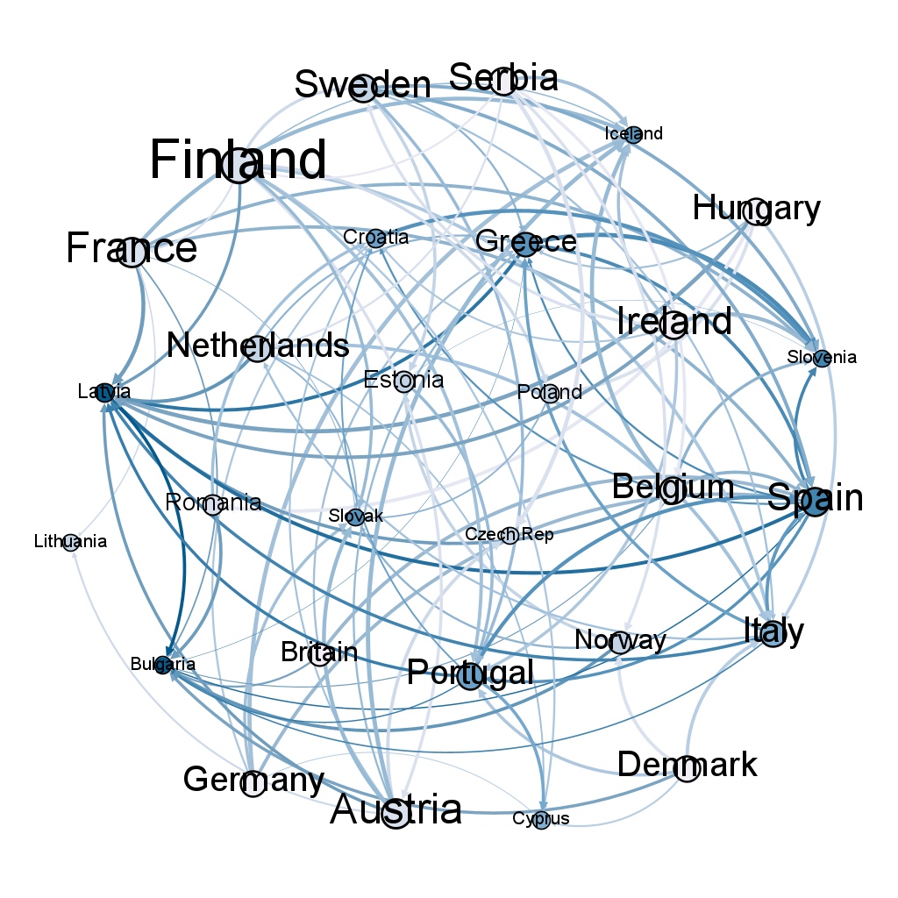
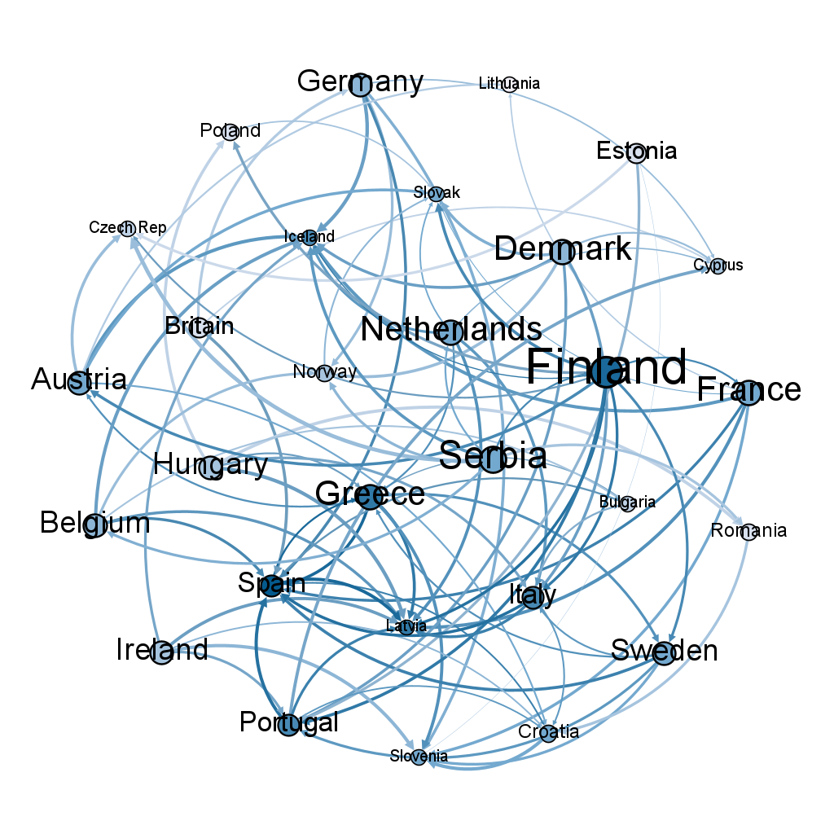
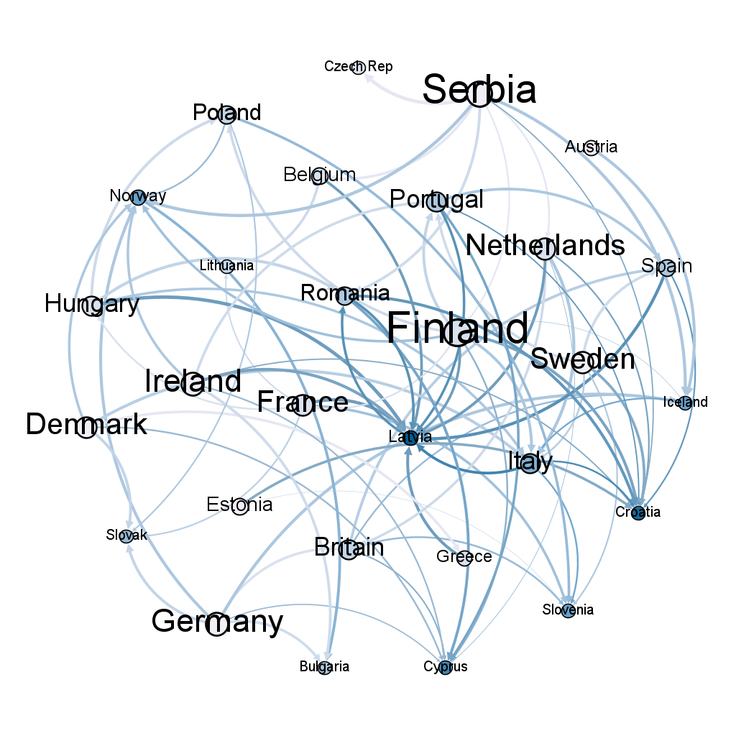
Appendix - Sovereign Networks
2019-01-24
2019-05-30
2019-10-03
2020-02-06
2020-06-12
2020-10-16
2021-02-19
2021-06-29
2021-11-03
2022-03-09
2022-07-13
2022-11-18
2023-03-24
2023-07-28

Slide 20
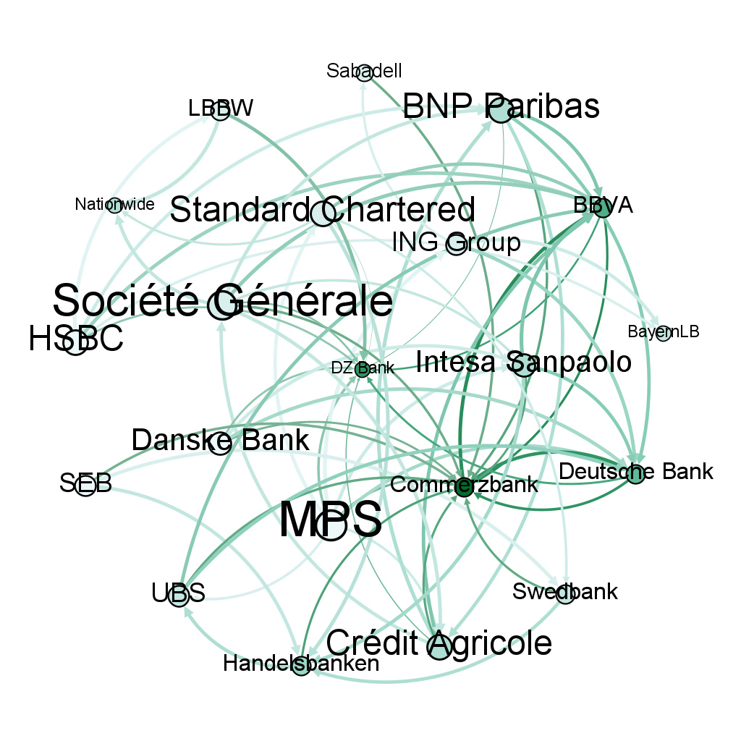
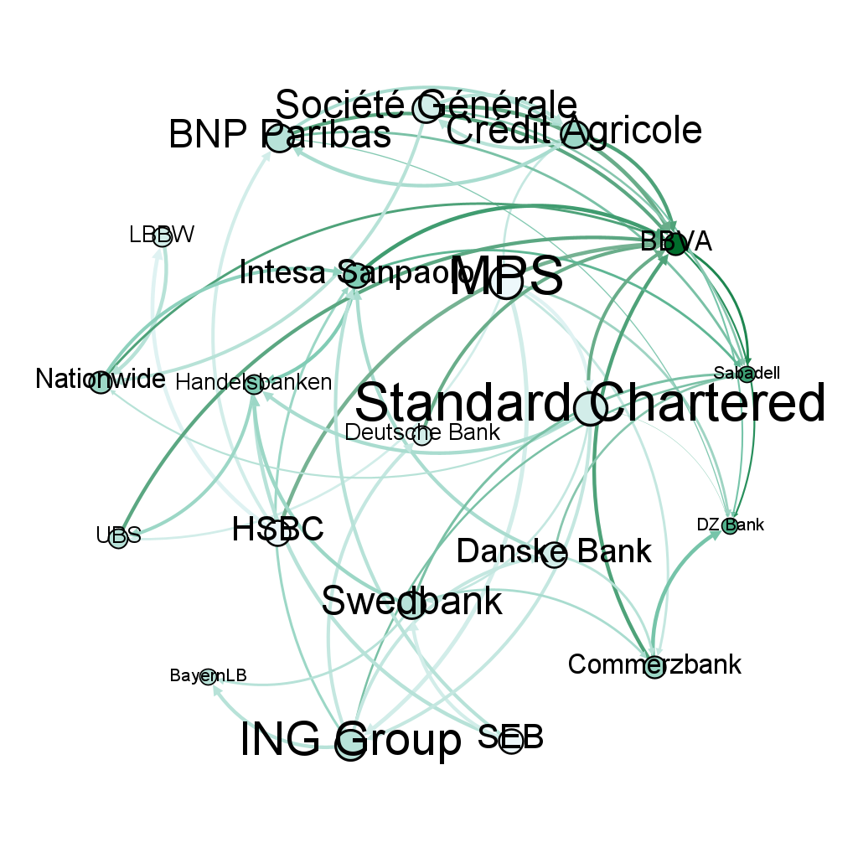
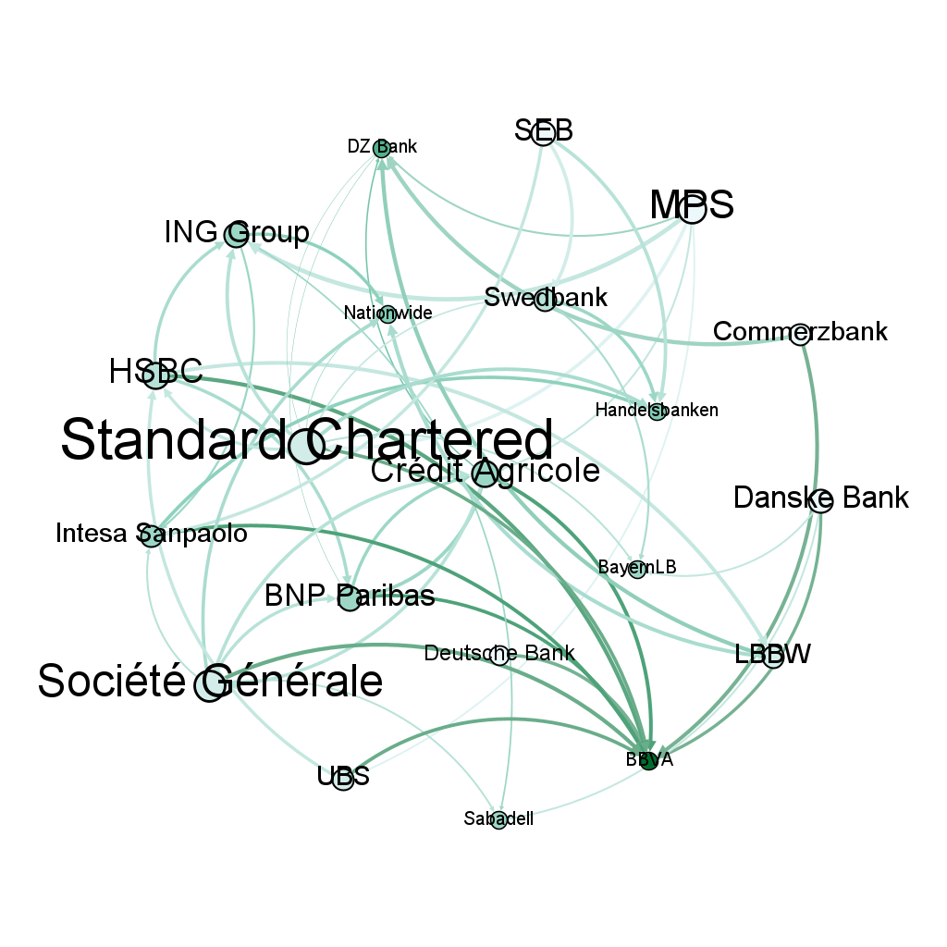
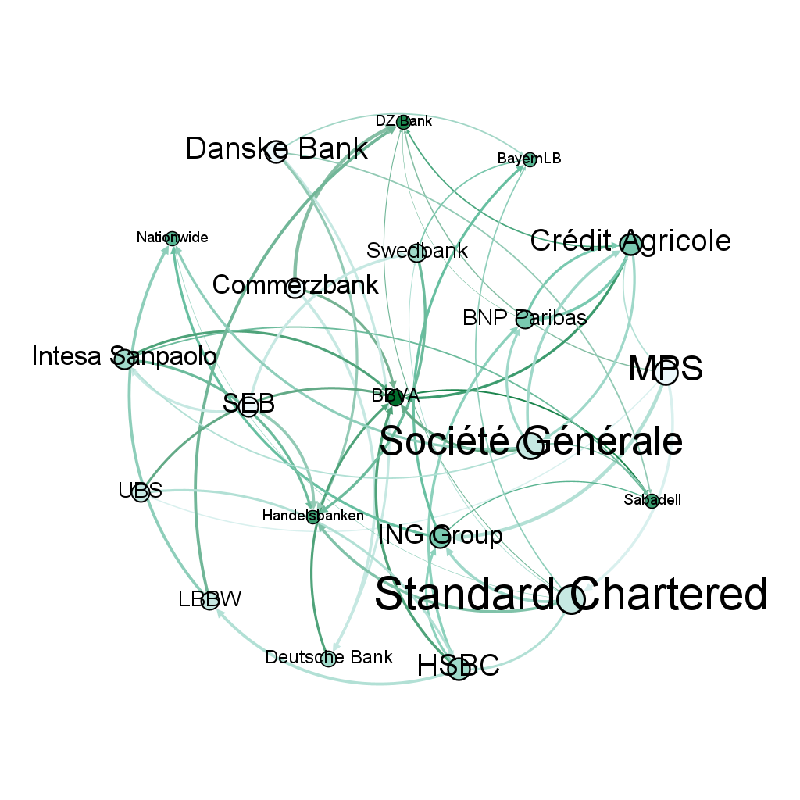
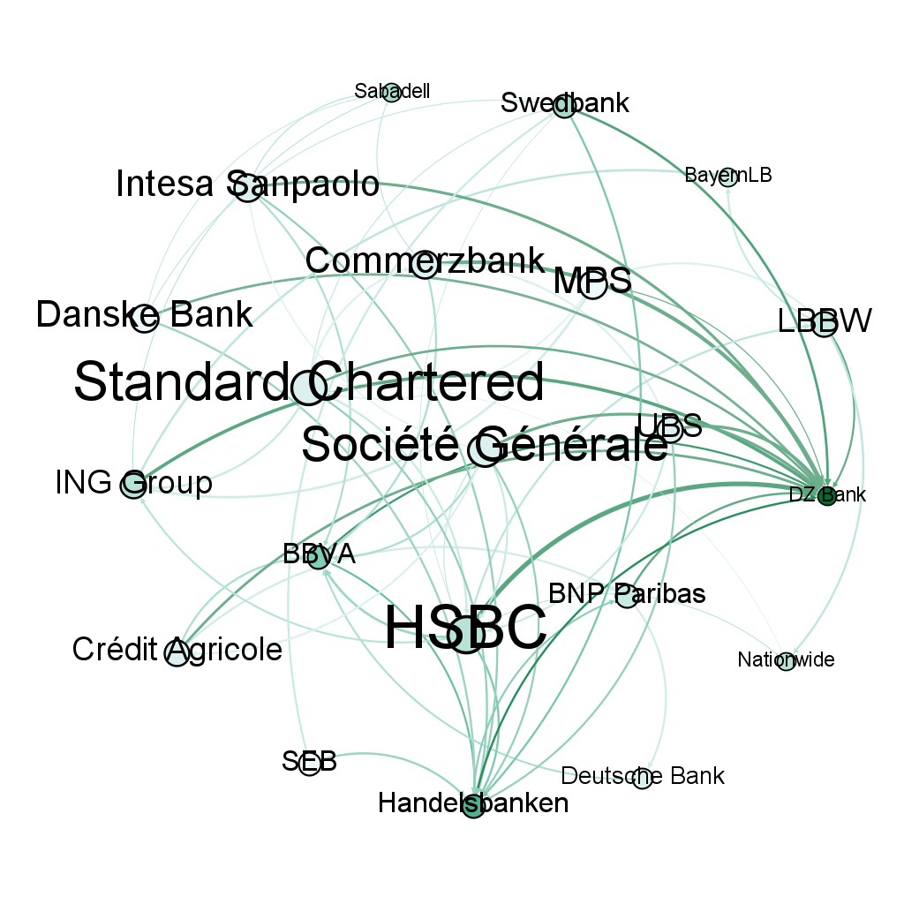
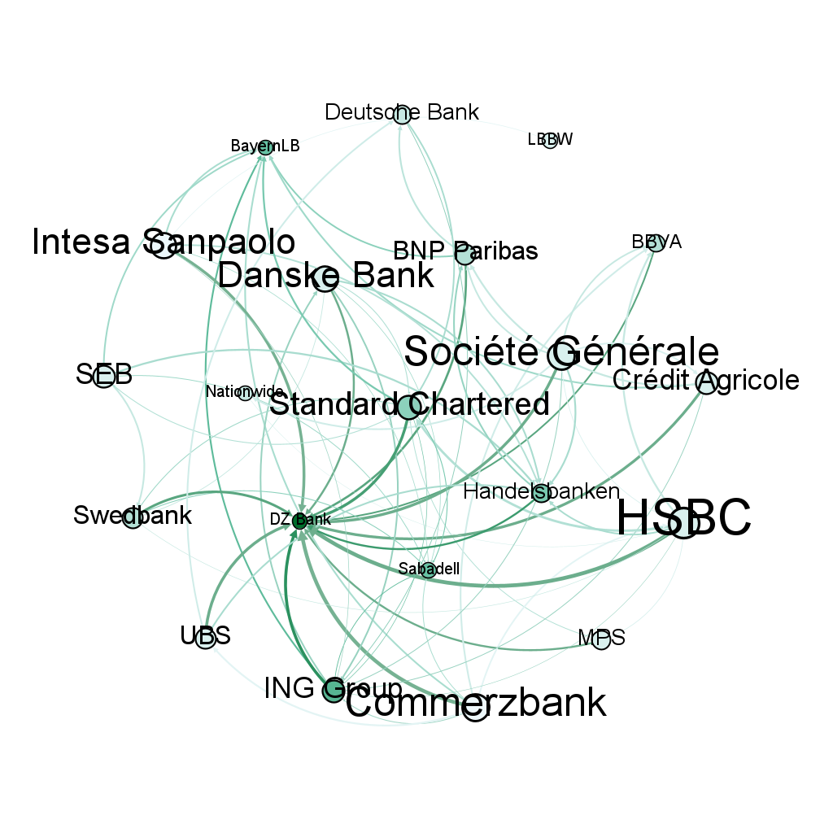
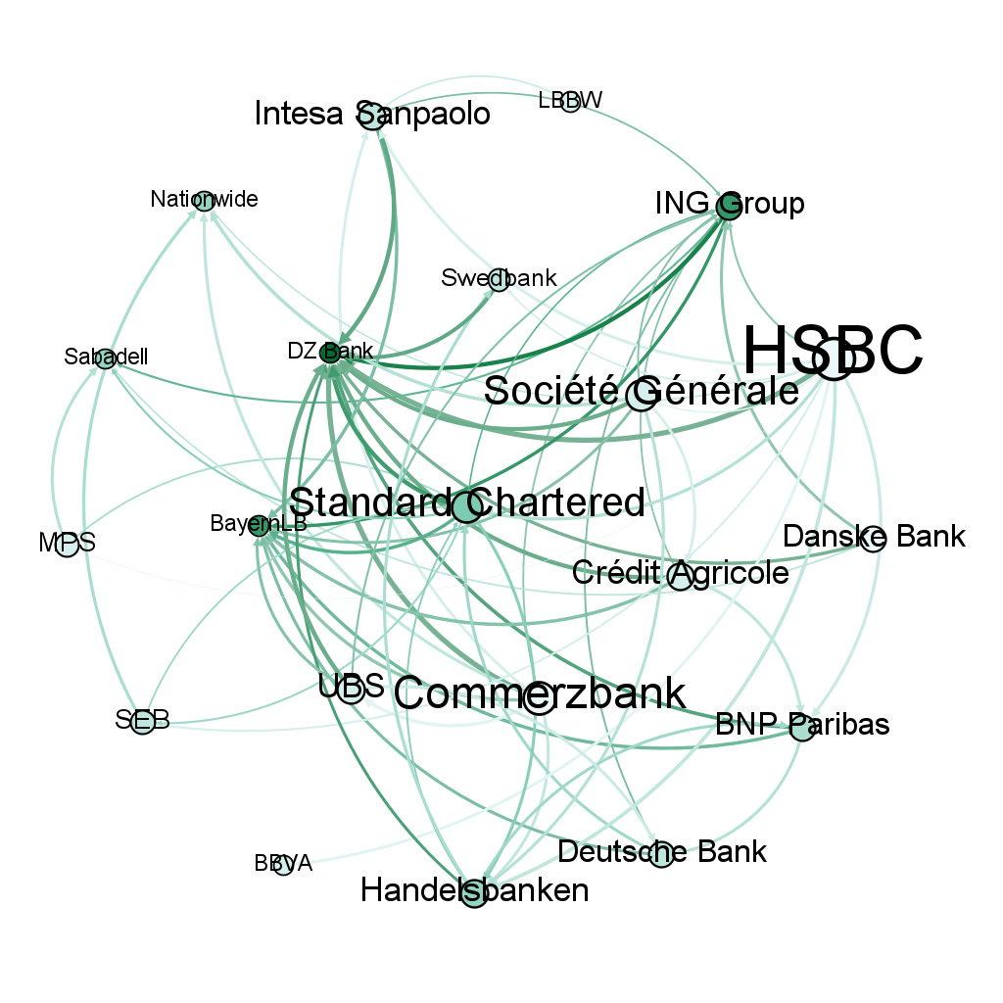
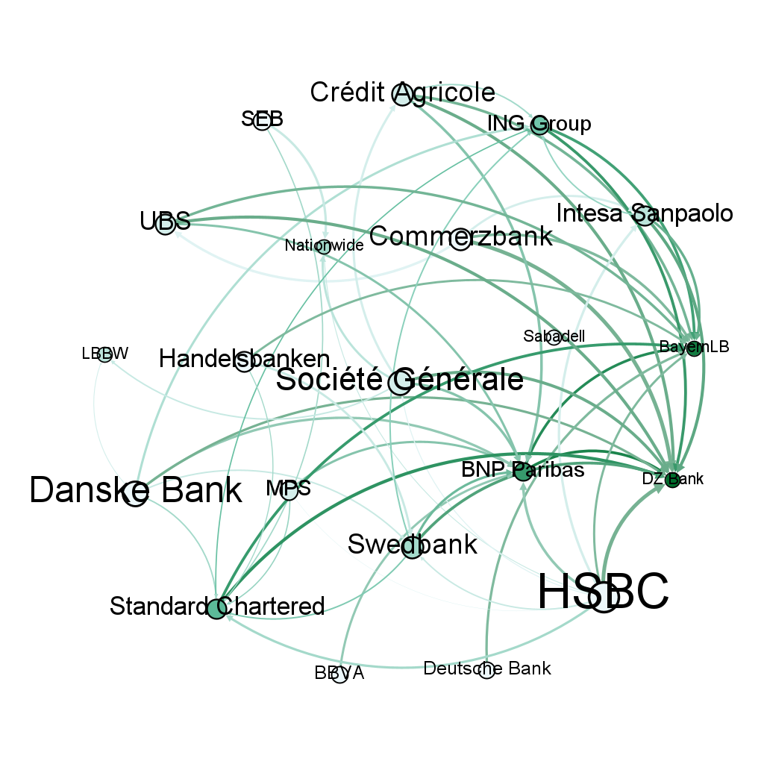





Appendix - Banking Networks
2019-01-24
2019-05-30
2019-10-03
2020-02-06
2020-06-12
2020-10-16
2021-02-19
2021-06-29
2021-11-03
2022-03-09
2022-07-13
2022-11-18
2023-03-24
2023-07-28

